Slide 1
RDE: Replay DEbugging for Diagnosing Production Site Failures
Peipei Wang¹, Hiep Nguyen², Xiaohui (Helen) Gu¹, Shan Lu³
North Carolina State University¹
Google Inc.²
University of Chicago³

Slide 2



Motivation
Reproducing production site failures is difficult
Lack environment information (e.g., user inputs, configuration files)
Miss interacting components (e.g., storage, third-party libraries)
Cannot
replay
Bug report
Production Site
Development Site

Slide 3




The State of the Art
Record and reply
High overhead
Privacy concerns
Deployment challenges
Development site
Production site
Notes:
Partial record and reply---privacy

Slide 4

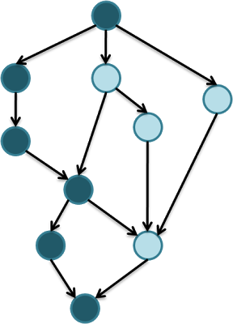



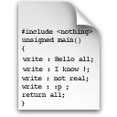

Our Approach
Production site
Onsite Failure Path Inference
[Insight ATC14]
Application binary
Environment
information
Inferred failure path
Development site
Failure-triggering
input
RDE
Developer
Debugger
source code
Notes:
Overall framework

Slide 5
Background
Insight: In-situ Online Service Failure Path Inference [Hiep et al ATC`14]
Onsite failure path inference within the production environments
Leverage production environment clues (e.g., configuration files, console logs, system call traces)
Notes:
Dynamic shadow server creation----Decouple analysis from the production run
When we say “Onsite”, we mean it collects runtime system call sequences

Slide 6


Onsite Failure Path Inference
Input: console log
1 log (“Checking request state in database”);
2 my @selected_rows = database_select ( $select_statement );
3 if ( ( scalar @selected_rows ) == 0 ) {
4 log (“0 rows returned from request state select
statement, request was probably deleted,
returning 0” );
5 return 0;
6 }else{
7 if ( ( scalar @selected_rows ) > 1 ) {
log (“More than 1 row returned from request state
select statement, returning 0” );
9 return 0;
10 }else{
11 log (“Start processing reservation”);
12 }
13 }
Checking request state in database
Start processing reservation
False
True
Unmatched
1
False
True
True
False
2
Unmatched
True
False
Matched
Output: inferred failure path
Notes:
Don’t need to read all points

Slide 7
Failure Reproduction Challenge
Infeasible path problem
Original failure-triggering user input is unavailable
Insufficient guidance during onsite failure path inference
Solution
Find a similar feasible path
bool make_dir_parents ( … )
….
if((parent_mode & WX_USR)…){
re_protect = true;
}else{
re_protect = false;
}
…
if(re_protect){ …. }
….
1
True
False
re_protect = true;
2
True
False
Notes:
This example is the example of infeasible inferred path: the bug for mkdir
It is a infeasible path because path constraint solver could not find correct value for re_protect
Both branches have no log messages. So both branches could be flippable

Slide 8
Guided Symbolic Execution
Console log
This is branch 1
Function end
void example (int a){
if (a>=2){
log(“This is branch 1”);
b=10;
}
if (a<=2 && b>7){
c=1;
}else{
c=2;
}
log(“Function end”);
1
True
False
2
True
False
Non-flippable branches
Flippable branches
Notes:
Concrete: determined condition value
Explored: undetermined condition value

Slide 9
Input Synthesis with Symbolic Execution
A symbolic execution path
void foo (int a){
1: if (a>=2)
2: … //do something
3: if (a<=2)
4: ... //do something
5: }
Input: a=2
1
True
False
2
True
False
Code line number: 1, 2, 3, 4
Path constraints: a>=2 and a<=2
Notes:
Don’t need to read all points

Slide 10
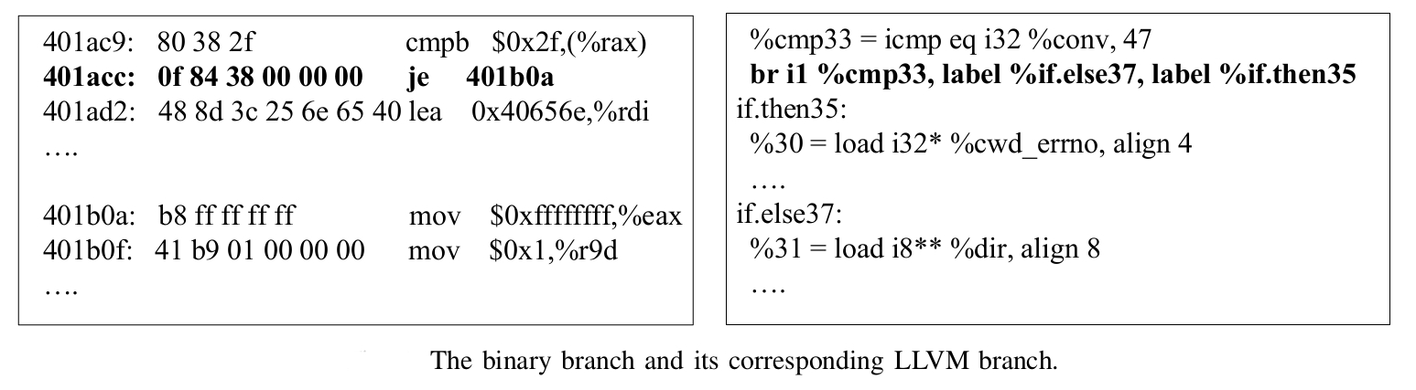
Implementation
Symbolic execution engine
KLEE [Cadar et al. OSDI 2008]
Path alignment
Branch mapping of the binary and the LLVM bitcode.
Notes:
Same compiler, similar code block layout, same branch order
Path alignment is because binary and bit-code using different code block layout
Binary: if true jump to higher address
Bitcode: if false jump to lower address

Slide 11
Evaluation Benchmarks
System name | LOC | Failure path length |  | Num. of console log messages | Num. of system calls | Successfully reproduced ?
 |  | Num. of functions | Num. of branches
mkdir | 400 | 2 | 42 | 2 | 202 | YES
rmdir | 200 | 2 | 23 | 3 | 198 | YES
ln | 600 | 2 | 43 | 2 | 186 | YES
touch | 500 | 1 | 7 | 1 | 188 | YES
cp | 1900 | 13 | 116 | 2 | 199 | YES
Notes:
Alternative input:: a different input but of the same type as the original input

Slide 12
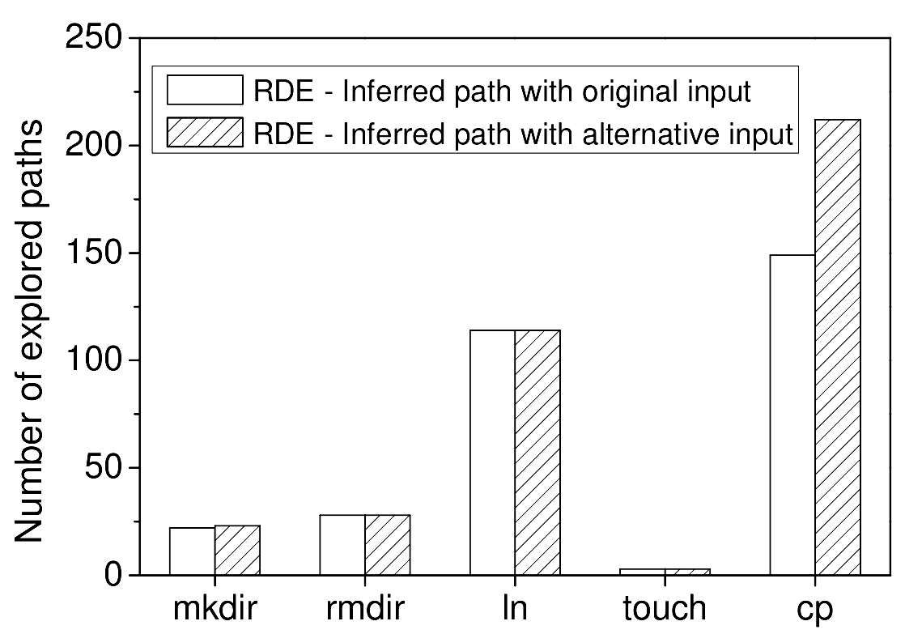
Guided Symbolic Execution Complexity
Notes:
Distance of call path between original path and RDE produced path
Distance of branch level between original path and RDE produced path
Traversed number of paths in RDE

Slide 13
Guided Symbolic Execution Time
Failure name | Inferred path setting | Path alignment | Input synthesis
mkdir | Original input Alternative input | 0.9 ± 0.1 s 0.9 ± 0.2 s | 2.3 ± 0.4 s 2.3 ± 0.3 s
rmdir | Original input Alternative input | 0.8 ± 0.1 s 0.8 ± 0.1 s | 1.8 ± 0.2 s 1.8 ± 0.3 s
ln | Original input Alternative input | 1.0 ± 0.1 s 1.0 ± 0.1 s | 3.2 ± 0.4 s 3.2 ± 0.5 s
touch | Original input Alternative input | 1.1 ± 0.1 s 1.2 ± 0.2 s | 2.1 ± 0.3 s 2.2 ± 0.3 s
cp | Original input Alternative input | 1.1 ± 0.1 s 1.1 ± 0.1 s | 3.8 ± 0.4 s 3.9 ± 0.3 s
Notes:
Alternative input is the same input of the original input, but different value

Slide 14
Related Work
Failure input synthesis
ESD [Zamfir et al. EUROSYS 2010]
Extract failure points from core dumps and use static control flow analysis to narrow down the symbolic execution space
RDE handles non-crashing failures and use runtime inferred failure path to speedup the symbolic execution
Better Bug Reporting [Castro et al. ASPLOS 2008]
Use symbolic execution along the known failure path to synthesize a set of inputs that are different from the original one.
RDE does not require exact failure path or any user input
Notes:
Don’t need to read all points

Slide 15
Related Work
Guided symbolic execution
Pathfinder [Pasareanu and Rungta ASE 2015]
Limits the loop iterations and recursions of symbolic execution for Java code.
Fitnex [Xie et al. DSN 2009]
Use a fitness function to measure the distance between a feasible path and a particular target
Different approaches to alleviate the space explosion problem of symbolic execution
Notes:
Fitness values measure the distance between a feasible path and a particular target

Slide 16
Limitation & Future work
Prohibitive symbolic execution overhead in library calls such as libc
Record exact path within library functions
Require symbolic execution engine to support production library
Support multi-process and multithreaded applications
KLEE does not support multi-process or multithreaded applications
Integrate with CLOUD9 [Bucur EUROSYS`2011]
Notes:
Could not use function call branches to guide symbolic execution into library function

Slide 17
Conclusion
RDE: Replay debugging for diagnosing production site failures
Reproduce production-site failure execution at the development site using inferred failure path
Provide guided symbolic execution exploration to synthesize failure-triggering user inputs.
Thank you!
Notes:
Don’t need to read all points

